Slide 1
I Stay At Home
Serverless solution to fill positivity around you
Theme: Being Socially Responsible/Social Good
Team: NoHup
Team Members:
Tanmay Singhal
Dipak Wani

Slide 2
Motivation: The why?
We need a reason for celebration, specially when we cannot go out
Productively utilise time
Realistic challenges
Sharing enthusiasm
Virtually connecting with our buddies for a purpose
Adding a purpose like sharing an innovative challenge
Sharing positivity on social media
For example, Ice bucket challenge shared on Instagram
Enthusiasm is more contagious than a virus

Slide 3
The Idea
📱A webapp platform to showcase a list of challenges
Example of challenges: See your childhood photos, Try old clothes, Create a meme, etc
🔝Users will complete challenges and gain points
Completing a challenge will earn user points
💯Celebratory image as a recognition once challenge is completed
💕Sharing options to share on Social Media and nominate friends
Share and earn more traction, in turn spread good vibes

Slide 4
Implementation
Front end hosted on S3 bucket
Get challenges from DynamoDB through API gateway
A unique user is created if existing user cookie is not found
When image is uploaded, lambda creates another achievement image and stores in S3
Same image is returned to UI, as a shareable content
User can update personal information on Profile page; User information stored in DynamoDB
Live Demo at : https://istayathome.in/

Slide 5
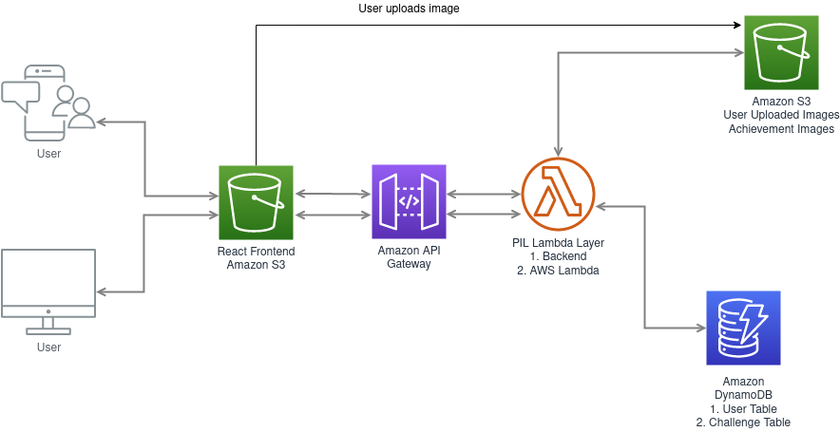

Slide 6
Business Value
Platform for hosting and sharing challenges
Challenges can range from clicking a selfie to completing online course
Gamification and making productive tasks fun
Tie Up with other growing businesses
User can redeem points for some merchandise
For example, T shirt websites, gifts
Schools, Institutions : To motivate students to take up school friendly challenges
Analytics
Categorical sentiment analysis of users vs challenges solved
Building a Friends network keeping data private
Challenge types to explore user characteristics
User targeted ads

Slide 7
Thank you
Github: https://github.com/tanmaysinghal98/istayathome
Live Demo: https://istayathome.in/

